Slide 1
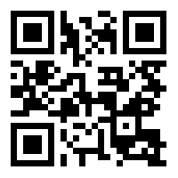
Communication and Programme visibility rules
Communication and Visibility Manual
https://huskroua-cbc.eu/documents/visibility-documents
Contact person
Viktoriia Taranenko / Communication Manager viktoriia.taranenko@szpi.hu
Joint Technical Secretariat
Hungary-Slovakia-Romania-Ukraine ENI CBC Programme 2014-2020 Tel: +36 20-236-6138 1053 Budapest, Szép u. 2 http://www.huskroua-cbc.eu/
https://www.facebook.com/huskroua.cbc
https://twitter.com/huskroua_cbc

